Slide 1


Annual General Meeting
December 7th 2017
Newry Co Down

Slide 2

Agenda
Welcome
Propose & Adopt Minutes of 2016 AGM
Address from Chairperson
BMX Racing in 2017 – summary
Plans for 2018
Treasurers Statement
National Track Development – update
Development Squad & National Team
Submissions for Discussion
Nominations
Thank You & CLOSE

Slide 3
BMX Racing in 2017
The 2017 Irish National BMX Race Series.
Round 1: April Lucan BMX, Co. Dublin
Round 2: May – Ratoath BMX, Meath
Round 3: May – Lisburn BMX
Round 4: July – Cork BMX, Co. Cork
Round 5: August – Lucan BMX, Co. Dublin
Round 6: August – Lucan BMX, Co. Dublin
Round 8: September – Ratoath BMX, Meath
Round 9: September – Ratoath BMX, Meath
Event 2017 | Total Entries | Boys | Girls
Round1 Luc | 165 | 138 | 27
Round2 Rat | 180 | 149 | 31
Round3 Lis | 146 | 117 | 29
Round4 Cork | 135 | 113 | 22
Round5 Wex | 144 | 115 | 29
Round6 Luc | 142 | 111 | 31
Round7 Luc | 143 | 112 | 31
Round8 Rat | 130 | 107 | 23
Round9 Rat | 133 | 110 | 23
Total Unique Riders 2017 |  | 227
The National Series had a total of 227 riders racing in 2017 up 6% on last year.
The 2017 All-Ireland Championships
- Lisburn BMX Club -
The Cycling Ireland BMX Commission would like to thank the fantastic volunteers of Lisburn BMX club for their tireless work to organise and host such a top class event. A fantastic day was had by all who attended.

Slide 4
BMX Clubs in Ireland
11 in total
Belfast Cork Dublin City BMX East Coast Raiders Lisburn Lucan Newry & Mourne Ratoath Courtown
Lagan Village St. Annes
BMX Club membership 2016(end Sept 2016) |  |  | BMX Club membership 2017(end sept 2017)
Belfast City BMX Club | 34 |  | Belfast City BMX Club | 57
Cork BMX Club | 61 |  | Cork BMX Club | 111
Riverchapel BMX Club | 60 |  | Courtown BMX Club | 163
DC BMX | 17 |  | DC BMX | 15
East Coast Raiders BMX Club | 11 |  | East Coast Raiders BMX Club | 9
Lagan Village BMX Club | 18 |  | Lagan Village BMX Club | 8
Lisburn BMX Club | 63 |  | Lisburn BMX Club | 67
Lucan BMX Club | 92 |  | Lucan BMX Club | 80
Newry & Mourne BMX Club | 6 |  | Newry & Mourne BMX Club | 6
Ratoath BMX Club | 43 |  | Ratoath BMX Club | 55
St. Annes BMX Co-op | 6 |  | St. Annes BMX Co-op | 8
Total BMX Licence holders | 411 |  | Total BMX License holders | 579
BMX license holders Increased by 40% in 2017

Slide 5
BMX Race Statistics 2011-2017
Rider Count Irish BMX National Series
Round | 2011 | 2012 | 2013 | 2014 | 2015 | 2016 | 2017 |  |  | Year | Round | Venue | Riders
Avg | 147 | 101 | 102 | 84 | 94 | 119 | 141 |  |  | 2011 | 1 | Ratoath | 147
Total | 147 | 229 | 193 | 147 | 148 | 211 | 223 |  |  | 2012 | 1 | Cherry Orchard | 85
1 | 147 | 85 | 118 | 90 | 100 | 120 | 161 |  |  |  | 2 | Cherry Orchard | 84
2 |  | 84 | 113 | 88 | 97 | 121 | 168 |  |  |  | 3 | Ratoath | 136
3 |  | 136 | 120 | 74 | 90 | 122 | 141 |  |  |  | 4 | Cherry Orchard | 90
4 |  | 90 | 104 | 94 | 78 | 90 | 135 |  |  |  | 5 | Ratoath | 109
5 |  | 109 | 85 | 76 | 95 | 120 | 136 |  |  |  | 6 | Ratoath | 90
6 |  | 90 | 99 | 79 | 104 | 121 | 138 |  |  |  | 7 | Ratoath | 116
7 |  | 116 | 83 |  |  | 128 | 135 |  |  | 2013 | 1 | DC | 118
8 |  |  | 100 |  |  | 130 | 127 |  |  |  | 2 | DC | 113
9 |  |  | 100 |  |  |  | 128 |  |  |  | 3 | Ratoath | 120
 |  |  |  |  |  |  |  |  |  |  | 4 | Ratoath | 104
 |  |  |  |  |  |  |  |  |  |  | 5 | DC | 85
 |  |  |  |  |  |  |  |  |  |  | 6 | Ratoath | 99
 |  |  |  |  |  |  |  |  |  |  | 7 | Ratoath | 83
 |  |  |  |  |  |  |  |  |  |  | 8 | DC | 100
 |  |  |  |  |  |  |  |  |  | 2014 | 1 | DC | 90
 |  |  |  |  |  |  |  |  |  |  | 2 | Ratoath | 88
 |  |  |  |  |  |  |  |  |  |  | 3 | Ratoath | 74
 |  |  |  |  |  |  |  |  |  |  | 4 | Lucan | 94
 |  |  |  |  |  |  |  |  |  |  | 5 | Ratoath | 76
 |  |  |  |  |  |  |  |  |  |  | 6 | Ratoath | 79
 |  |  |  |  |  |  |  |  |  | 2015 | 1 | Lucan | 100
 |  |  |  |  |  |  |  |  |  |  | 2 | Ratoath | 97
 |  |  |  |  |  |  |  |  |  |  | 3 | Cork | 90
 |  |  |  |  |  |  |  |  |  |  | 4 | Lucan | 78
 |  |  |  |  |  |  |  |  |  |  | 5 | Ratoath | 95
 |  |  |  |  |  |  |  |  |  |  | 6 | Ratoath | 104
 |  |  |  |  |  |  |  |  |  | 2016 | 1 | Lucan | 120
 |  |  |  |  |  |  |  |  |  |  | 2 | Lisburn | 121
 |  |  |  |  |  |  |  |  |  |  | 3 | Riverchapel | 120
 |  |  |  |  |  |  |  |  |  |  | 4 | Cork | 90
 |  |  |  |  |  |  |  |  |  |  | 5 | Lucan | 120
 |  |  |  |  |  |  |  |  |  |  | 6 | Lucan | 121
 |  |  |  |  |  |  |  |  |  |  | 7 | Ratoath | 128
 |  |  |  |  |  |  |  |  |  |  | 8 | Ratoath | 130
 |  |  |  |  |  |  |  |  |  | 2017 | 1 | Lucan | 161
 |  |  |  |  |  |  |  |  |  |  | 2 | Ratoath | 168
 |  |  |  |  |  |  |  |  |  |  | 3 | Lisburn | 141
 |  |  |  |  |  |  |  |  |  |  | 4 | Cork | 135
 |  |  |  |  |  |  |  |  |  |  | 5 | Courtown | 136
 |  |  |  |  |  |  |  |  |  |  | 6 | Lucan | 138
 |  |  |  |  |  |  |  |  |  |  | 7 | Lucan | 135
 |  |  |  |  |  |  |  |  |  |  | 8 | Ratoath | 127
 |  |  |  |  |  |  |  |  |  |  | 9 | Ratoath | 128

Slide 6

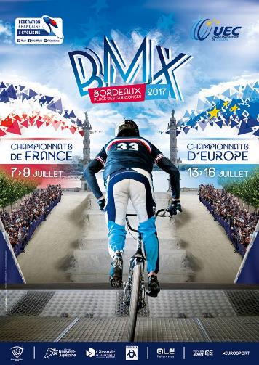
International BMX Racing in 2017
UCI BMX Worlds Rockhill USA
  Ireland represented with 5 riders
  in the Challenge class
  2018-Azerbaijan
  2019-Zolder Belgium
British Nationals & Euro Champs
  Riders From Ireland at UK races –
  37 riders represented Ireland
  2 riders in Junior men class
  Carly Hayes European No 6 Plate –
  2018 Sarrians France
  2019 Latvia
  2020 Dessel Belgium

Slide 7

Our National Race Series
Sponsors in 2017
BMX Commission Annual Report 2017
available in the ‘About’ section on bmxireland.ie

Slide 8
Plans for 2018
Formation of new BMX Commission
Encourage Cross-club Help for National Race Days
Encourage Coaching at Club level
Deliver Level 1 Coaching courses
Commissaire and BEM Training
National Champs in Ratoath
National Track Building
National Team & Development Squad promotion
Invest in inflatable finish line arch and banners
Rider support for Worlds & Euro Champs
End of Season Awards Ceremony 2018

Slide 9
National Race Series 2018
2018 Irish BMX National Series (10 rounds):
Round 1 – Lucan BMX Club – Sunday 8th April
Rounds 2 & 3 – Lisburn BMX Club – Saturday 12th & Sunday 13th May
Round 4 – Courtown BMX Club – Sunday 24th June
Rounds 5 & 6 – Cork BMX Club – Saturday 28th & Sunday 29th July
Rounds 7 & 8 – Ratoath BMX Club – Saturday 18th & Sunday 19th August
Rounds 9 & 10 – Lucan BMX Club – Saturday 15th & Sunday 16th September
The 2018 All Ireland BMX National Championship will be held at Ratoath BMX Club on Sunday 1st July.
The 2018 Provincial Championships will be held in Cork, Courtown and Lisburn on Sunday 2nd September.

Slide 10
Increase in CI licence fees for 2018
General increase of €10/£10
The following were the accepted fees for 2018 at CI AGM Nov 11th 2017
Youth U8, U10 €10 / £9
Youth U12, U14 €20 / £18 •
Limited Competition License €80 / £72 •
Family Membership €85 / £77 •
Leisure Membership in regions (10% reduction for perpetual 5 year recurring Direct Debit) •
Connacht, Leinster & Munster €50 (includes €5 provincial levy) Ulster €56 / £52 (includes £10 / €11 provincial levy) •
Full Competition License €135 / £122
NB. All club committee members must hold a leisure/Supporter licence

Slide 11
Cycling Ireland BMX Commission
AGM 2017
Treasurers Statement
Nathalie Lawlor

Slide 12

2017 Financial summary
2017 Financial Summary
Income |  |  |  |  | Jeremy Hayes
Opening Balance | €2,862.07 |  |  |  | 50% - Orientation weekend |  | €470.00 | (Invoice 0717)
Paypal | €29,746.95 | (Race entry fees 2017) |  |  | 50% - Selection weekend |  | €378.83 | (Invoice 0817)
Cycling Ireland | €5,000.00 | (Commission Budget) |  |  |  |  | €848.83
Total Income | €37,609.02 |  |  |  | Fees
 |  |  |  |  |  | Bank fees | €48.58
 |  |  |  |  |  | Paypal fees | €1,343.25
 |  |  |  |  |  |  | €1,391.83
Expenditure
Race Series | Race Fees | €15,045.00 |  |  | Superclass payouts
 | First Aid | €3,600.00 |  |  |  | Round 1 | €315.00
 | Trophies | €3,691.13 |  |  |  | Round 2 | €210.00
 |  | €22,336.13 |  |  |  | Round 5 | €140.00
 |  |  |  |  |  | Rds 6 & 7 | €280.00
All Ireland's |  |  |  |  |  | Rds 8 & 9 | €280.00
 | Race Fees | €1,620.00 |  |  |  |  | €1,225.00
 | Medals | €216.26
 |  | €1,836.26 |  |  | Miscellaneous
 |  |  |  |  | Expenses/AGM etc |  | €565.00
End of year Awards
 | Red Cow Inn | €1,370.00
 | Medals | €386.59 |  |  | Total Income | €37,609.02
 | Plates | €206.00 |  |  | Total Expenditure | €37,031.06
 | Printing plates | €385.61 |  |  |  | €577.96
 |  | €2,348.20
Euro & World competitions
 | Race Entries | €2,838.00
 | Spin 11 | €1,966.58
 | Miscellaneous | €1,675.23
 |  | €6,479.81

Slide 13
Cycling Ireland BMX Commission
AGM 2017
National Track Development
Update
Eamonn Wyer

Slide 14

BMX Irelands strategy formulation group identified Track Building as the single most important issue in Irish BMX. This hasn’t changed since 2014!
We need the facilities to attract the riders to grow the sport.
“Build it and they will come.”

Slide 15
Developed a track certification system
  RoSPA
  Track Building Guidelines
Built 5 National Standard Tracks in 6 Years
Built a National Sport which is as run to a better standard than most other BMX countries in the World.
215 riders in National series. Per capita – 2.4 times bigger than Britain, 11 times bigger than USA.
Our events attract more riders than Downhill MTB, Cross Country MTB, Cyclo Cross and Track Cycling.

Slide 16
2011
Ratoath
2012
Cherry Orchard Indoor Track (later DC, now gone)
2014
Lucan (first Funded Track in Ireland)
Ormeau (not used)
2015
Cork
Ratoath – Track upgrades with a new gate and hill

Slide 17
2016
Riverchapel (Courtown)
Lisburn
2017
Lucan – Pump Track – complete

Slide 18
2018 +
Armagh – Euroservices Started November 2017 – Regional Track
Athlone – Plan for 2018 Completion.
Fingal:
  Baleally – (Lusk Dump near Dublin Airport) Regional Track (High Probability of success)
  Baldoyle Supercross Track
South Dublin:
  Firhouse – National Track in Dodder Valley Park. Planning Passed.
  Jobstown – given to Achon to design.
Kildare - Athy – some plans submitted, no dates or locations.
Belfast
  Castlereagh Henry Jones Playing Fields
  Ormeau – Built – unused.
Larne
Newry
Navan
Carlow

Slide 19
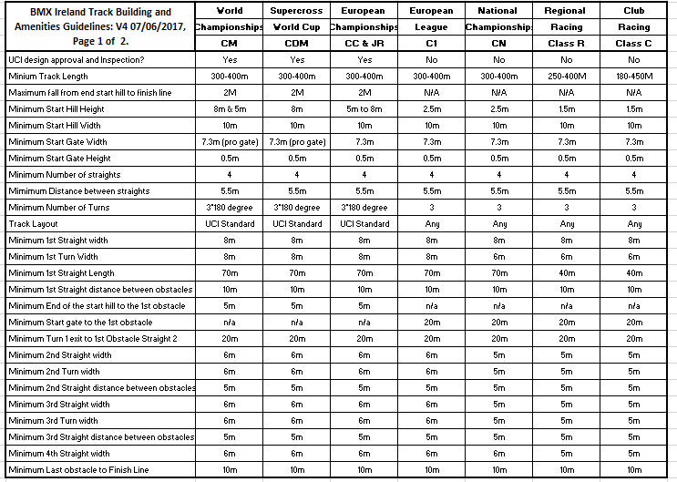

Slide 20
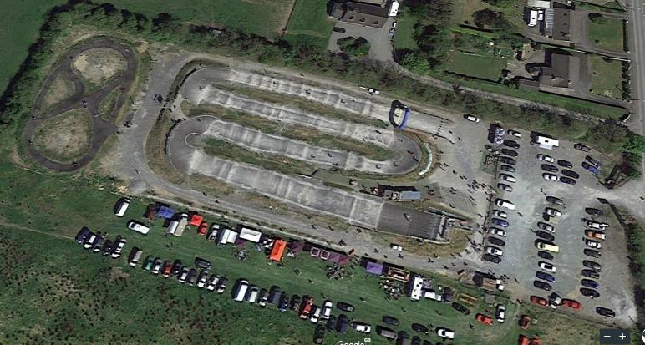
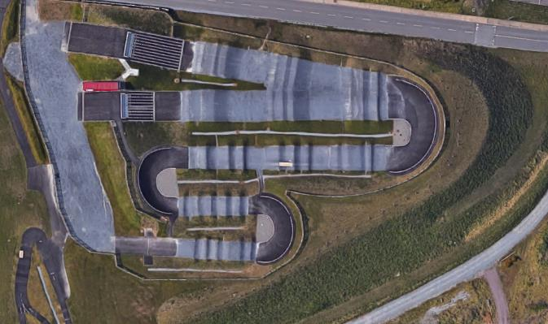
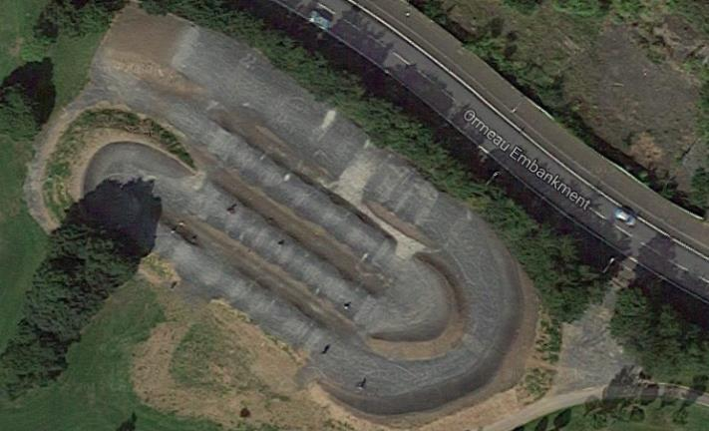
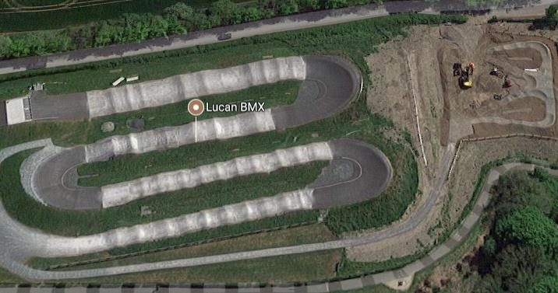

Slide 21
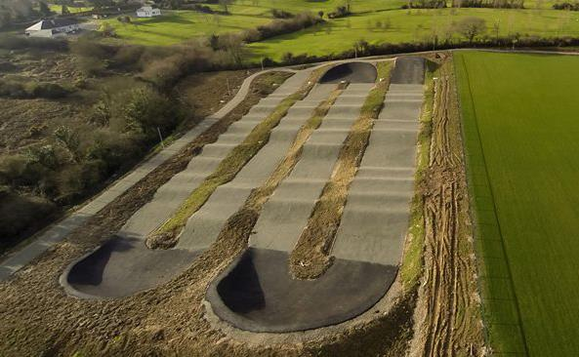
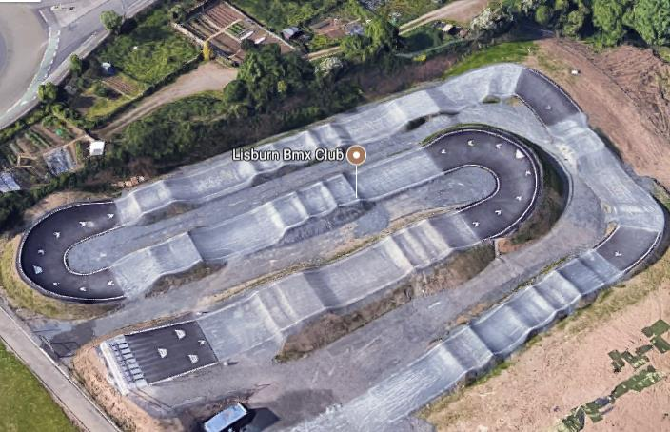

Slide 23
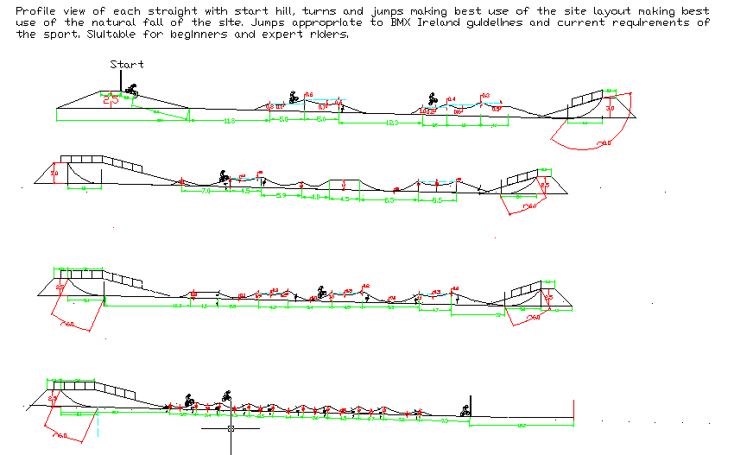

Slide 24
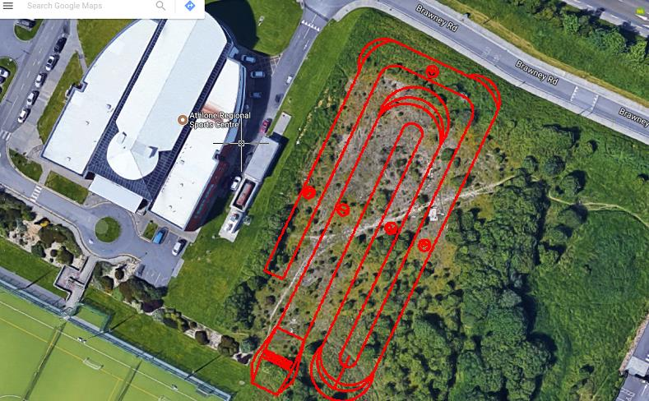

Slide 25
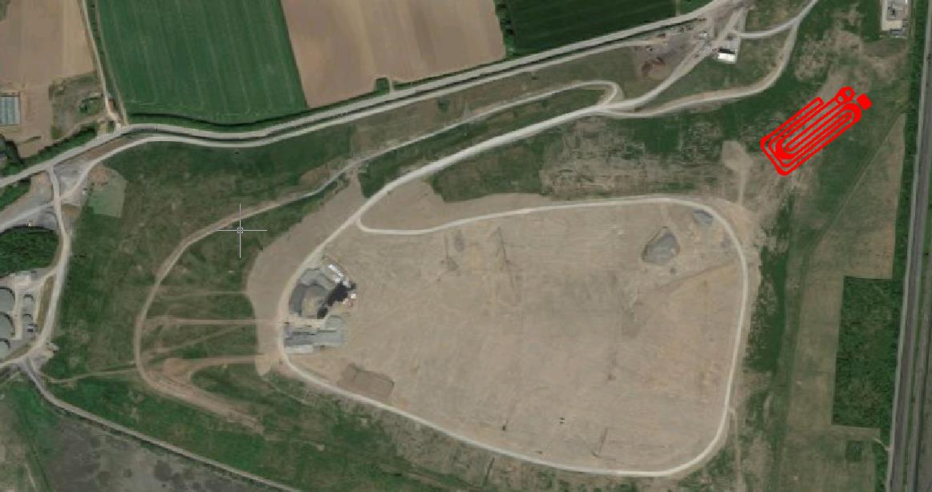
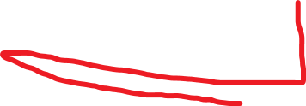


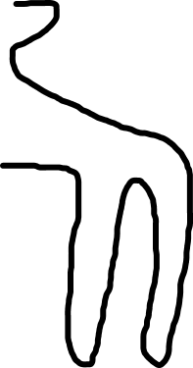
Sample Layout and Space required for the “Balleally” Regional BMX Track, pump track and Purple, Red and Black grade Mountain bike trails from the top to the bottom of the hill on the Civic Amenity.

Slide 26
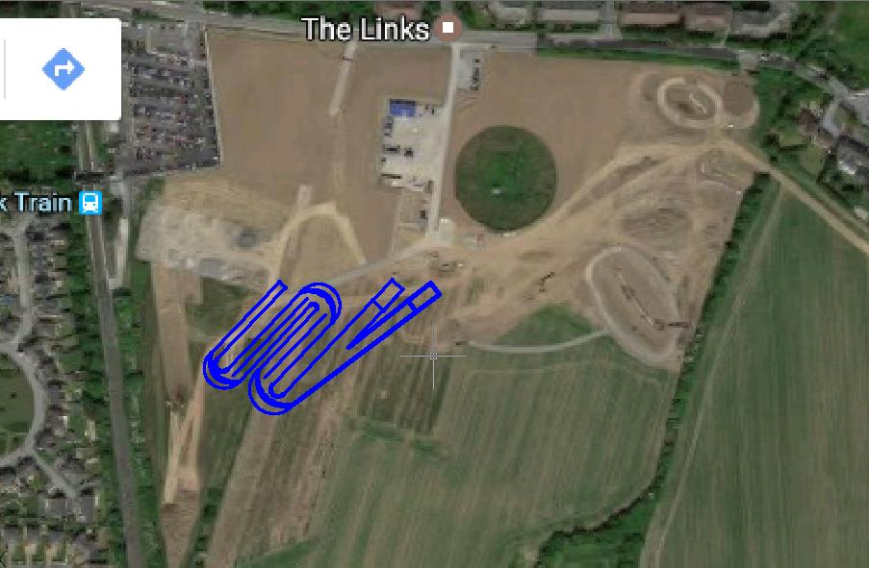
Sample Layout and Space required for the “Baldoyle” Combined Olympic/World and National BMX Track with dual 5M and 8M start hills, seven straights, 3 for each hill and one combined final straight.

Slide 27
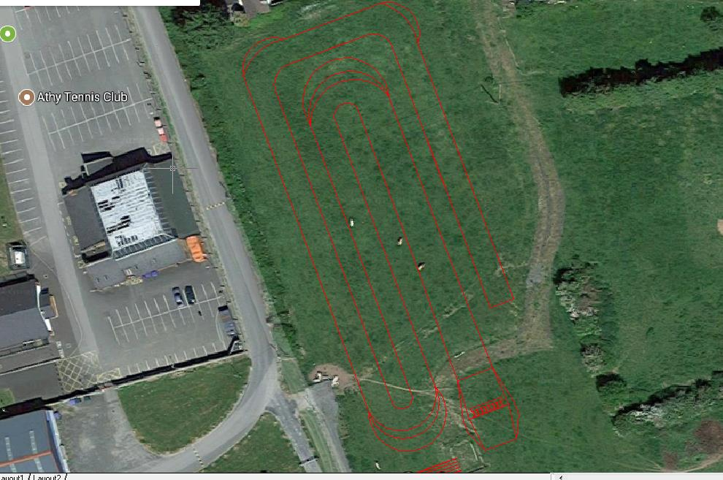

Slide 28
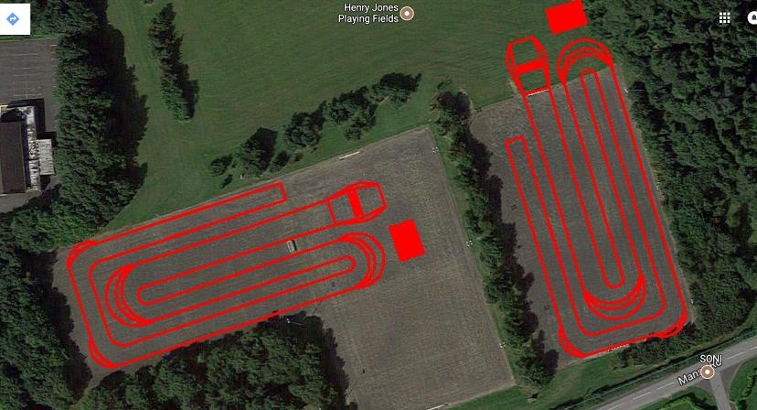

Slide 29
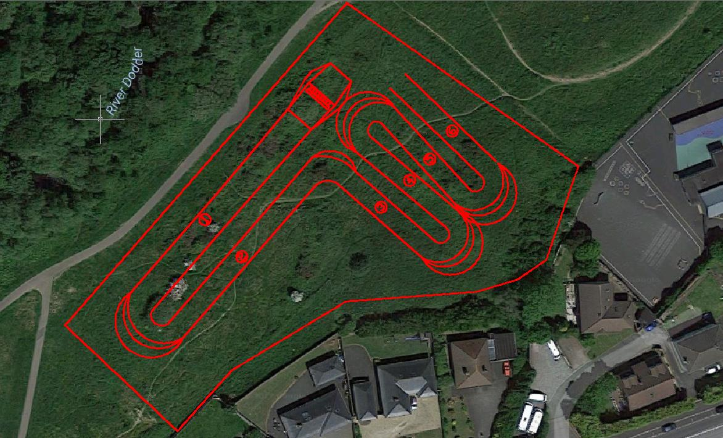
Mount Carmel #3

Slide 30
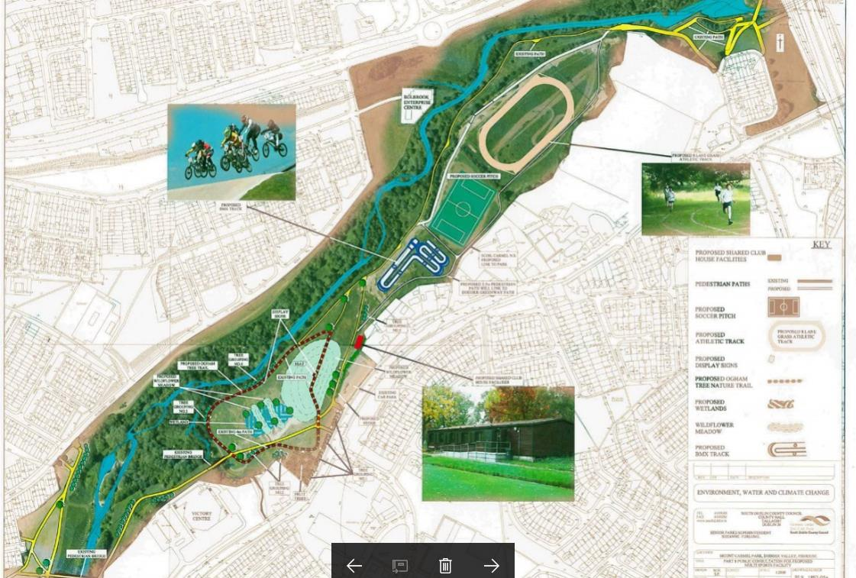
Mount Carmel #3

Slide 31
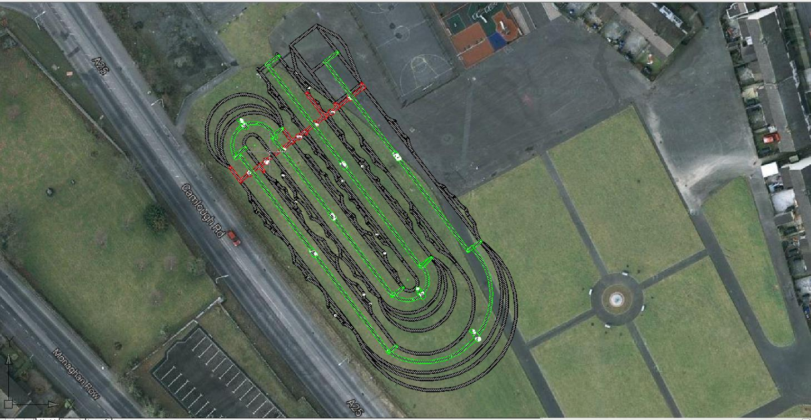
Newry

Slide 32
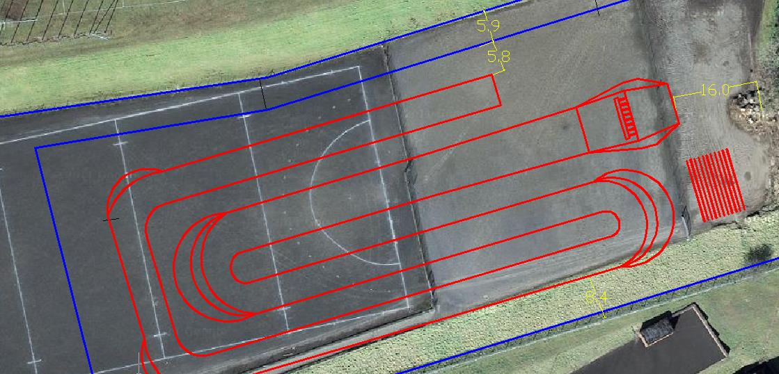

Slide 33
Cycling Ireland BMX Commission
AGM 2017
BMX Development Squad &
National Team
Simon Murphy

Slide 34
BMX Development Squad &
National Team
NATIONAL TEAM:
Aaron Edwards, Matthew Malone, Sam Murphy
SENIOR DEVELOPMENT SQUAD:
David Dorney, Matthew Campbell, Marcus Bell
NEW JUNIOR SQUAD:
Ciara O’Gorman, Niall Davis, Ryan Quinn, Calvin Dunne

Slide 35
BMX Development Squad &
National Team
Aim
To continue building on the progress already made with the development squad over the past year.
Ensure riders making significant gains are constantly challenged to continue to stimulate their development and race performance.
Why
To produce athletes capable of making finals in the UK National Series and possibly further afield in the 14-16 and 17-24 age categories with a long term aim of racing competitively in the European Race Series.
What
Continue the S&C support from DCU.
Focus on longer more intense multi day residential camps supported by shorter weekend camps and single day team sessions.
Enter all rounds of the UK National Series
Exposure to the European Race Series

Slide 36
BMX Development Squad &
National Team
How
Weekly Sessions
Delivered by local BMX Coach under advice of Programme Coach.
Focusing on core skills and physical conditioning as part of their training programme (a facilitator coach).
CYCLING IRELAND FUNDING AND SPONSORSHIP
Cycling Ireland funding for the national team and squad is €30,000 for 2018.
SPONSORS FOR 2018:
Principal Environmental - €2,000
Congress Print & Design - €2,000
Donations - €700
Pure Bicycle Company are supplying the national team with frames
Tog 24 are kitting the team and squad out

Slide 37
BMX Development Squad &
National Team
Programme Development
It’s important we recognise the different developmental rates of our riders, either through natural maturity or hard work and create an elevated environment for those riders to flourish. Whilst still allow others to continue their own progression, be it at a slower rate.
I believe we are now at a stage where we could have at least two distinct groups, not dissimilar to British Cycling’s ODP and Talent programmes but rather than different programmes they will fall in to ability groups due to the smaller numbers in Ireland. I need to think about this in more detail and discuss my thoughts with the BMX Commission but I do think it will look something like this.
National Team
Development Squad 16+
Junior Squad 14+

Slide 38
BMX Development Squad &
National Team
UCI TALENT CAMP SWITZERLAND
Two of our national team got selected to attend a two week talent camp in Switzerland. This is a result of years of consistent training and competing at a high level, the reports back show we have two skilful riders that need to increase their level of intensity when they race and to enter bigger and more competitive races on a more regular basis. This is the area the other riders should aspire to enter into.

Slide 39
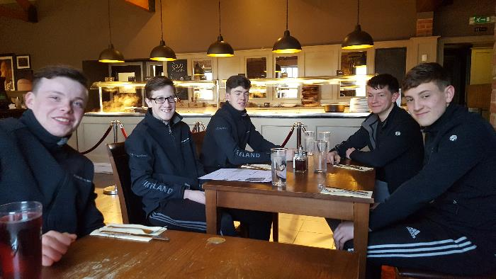
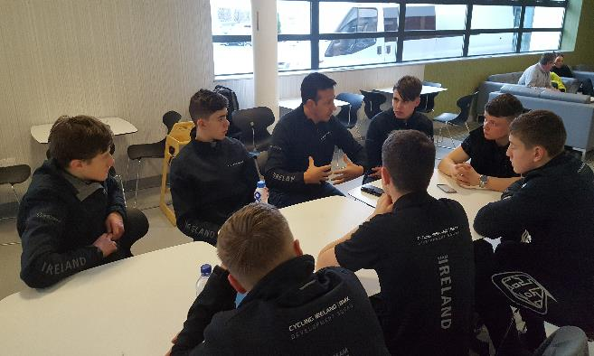
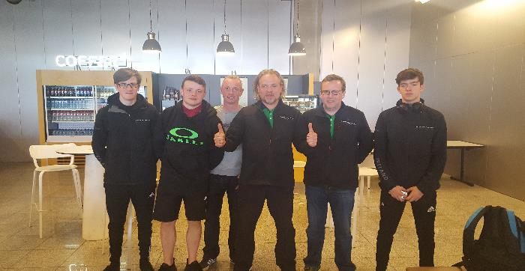
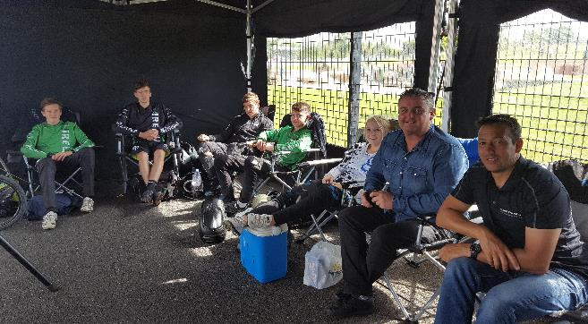
BMX Development Squad &
National Team

Slide 40
Submissions For Discussion
Standardization of Race Number plates (Ratoath)
Adherence to Article 7. Section 9 (BMX Rules)
i. Elite Men: White Plate, Black Numbers
ii. Junior Men: Black Plate, White Numbers
iii. Championship Women: Black Plate, White Numbers
iv. Men/Boys: Yellow Plate, Black Numbers
v. Girls: Blue Plate, White Numbers
vi. Cruiser: Red Plate, White Numbers

Slide 41
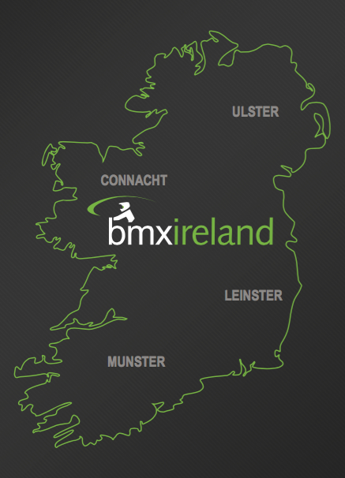
Nominations For 2018
Ulster
Jonathon Reid – Club nominee
Bill Mackness – Provincial nominee
Kevin McShane - Club nominee
Leinster
Eamonn Wyer – Provincial nominee
Karl Clancy – Club nominee
Eugene Jackson - Club nominee
Nathalie Lawlor - Club nominee
Tom Campbell - Club nominee
Richie Fields - Club nominee
Amanda Stynes - Club nominee
Shay McNally – Club nominee
Munster
Work in progress
Connacht
Work in Progress

Slide 42
Cycling Ireland BMX Commission
AGM 2017
Thank You & Close

